Slide 1






How it Works
You post your requirement directly or
‘book a consultant’, if required
Our matching algorithms get you the 3 most suited proposals in 72 hours
You select the right partner, use our processes to define goals/ milestones
Use simple tools & our support to be on top of delivery schedule & quality
Approve work, release payments & review partner basis delivery

Slide 2




Benchkart Assurance
Customised
Consultant support for Projects of any size & complexity
Curated
Rigorous Assessments to get you the finest Partners
Cost-effective
Automated solutions to save Resources, Time & Money
Secure
Safety for your Payments, Data, Delivery & Support

Slide 4





How it Works

Slide 5
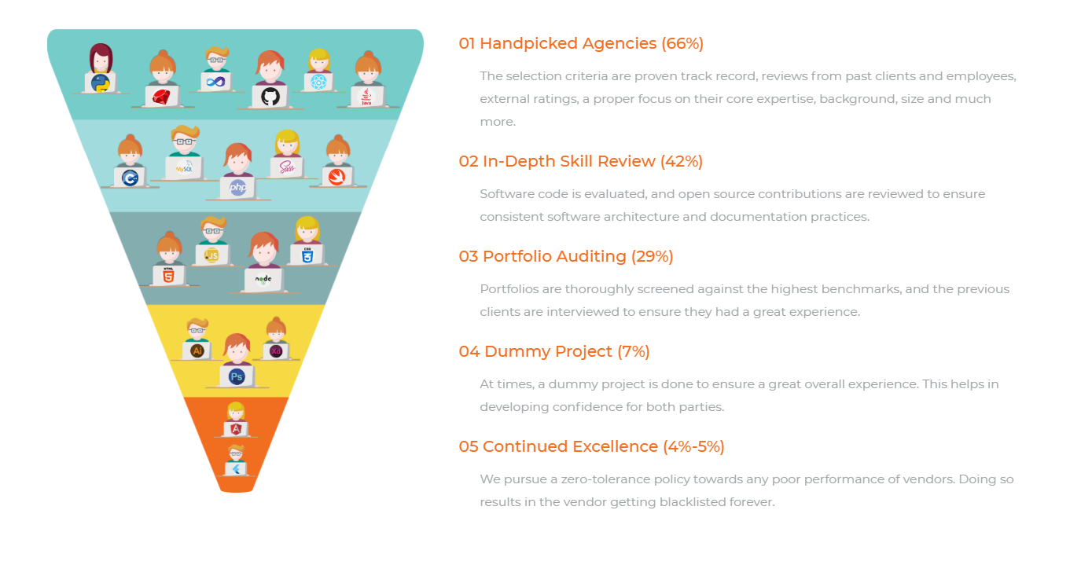

Slide 6


Slide 7


Slide 8


Slide 9


